Slide 1

CHAPTER 5
SEQUENCES,
MATHEMATICAL
INDUCTION, AND
RECURSION
Copyright © Cengage Learning. All rights reserved.

Slide 2
SECTION 5.9
General Recursive Definitions and Structural Induction
Copyright © Cengage Learning. All rights reserved.

Slide 3
Recursively Defined Sets

Slide 4
Recursively Defined Sets
To define a set of objects recursively, you identify a few core objects as belonging to the set and give rules showing how to build new set elements from old.
More formally, a recursive definition for a set consists of the following three components:
I. BASE: A statement that certain objects belong to the set.
II. RECURSION: A collection of rules indicating how to form
new set objects from those already known to be in the
set.

Slide 5
Recursively Defined Sets
III. RESTRICTION: A statement that no objects belong to the set other than those coming from I and II.

Slide 6
Example 1 – Recursive Definition of Boolean Expressions
An expression composed of boolean variables letters from the alphabet such as p, q, and r, and the connectives ∧, ∨, and ~ is called boolean expression.
To make precise which expressions are legal, the set of Boolean expressions over a general alphabet is defined recursively.
I. BASE: Each symbol of the alphabet is a Boolean
expression.

Slide 7
Example 1 – Recursive Definition of Boolean Expressions
cont’d
II. RECURSION: If P and Q are Boolean expressions, then
so are
(a) (P ∧ Q) and (b) (P ∨ Q) and (c) ~P.
III. RESTRICTION: There are no Boolean expressions over
the alphabet other than those obtained from I and II.
Derive the fact that the following is a Boolean expression over the English alphabet {a, b, c, . . . , x, y, z}:
(~(p ∧ q) ∨ (~r ∧ p)).

Slide 8
Example 1 – Solution
(1) By I, p, q, and r are Boolean expressions.
(2) By (1) and II(a) and (c), (p ∧ q) and ~ r are Boolean expressions.
(3) By (2) and II(c) and (a), ~(p ∧ q) and (~ r ∧ p) are Boolean expressions.
(4) By (3) and II(b), (~ (p ∧ q) ∨ (~ r ∧ p)) is a Boolean expression.

Slide 9
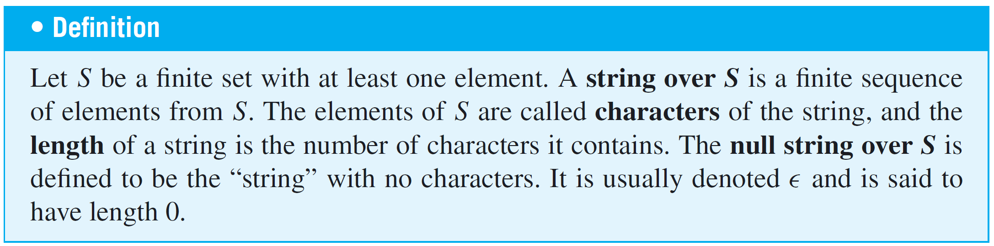
Recursively Defined Sets

Slide 10
Example 4 – Parenthesis Structures
Certain configurations of parentheses in algebraic expressions are “legal” [such as(())() and()()()], whereas others are not [such as)())) and()))((( ].
Here is a recursive definition to generate the set P of legal configurations of parentheses.
I. BASE: () is in P.
II. RECURSION:
a. If E is in P, so is (E).
b. If E and F are in P, so is EF.

Slide 11
Example 4 – Parenthesis Structures
cont’d
III. RESTRICTION: No configurations of parentheses are in P other than those derived from I and II above.
Derive the fact that (())() is in P.
Solution:
(1) By I, () is in P.
(2) By (1) and II(a), (()) is in P.
(3) By (2), (1), and II(b), (())() is in P.

Slide 12
Proving Properties about Recursively Defined Sets

Slide 13
Proving Properties about Recursively Defined Sets
When a set has been defined recursively, a version of mathematical induction, called structural induction, can be used to prove that every object in the set satisfies a given property.

Slide 14
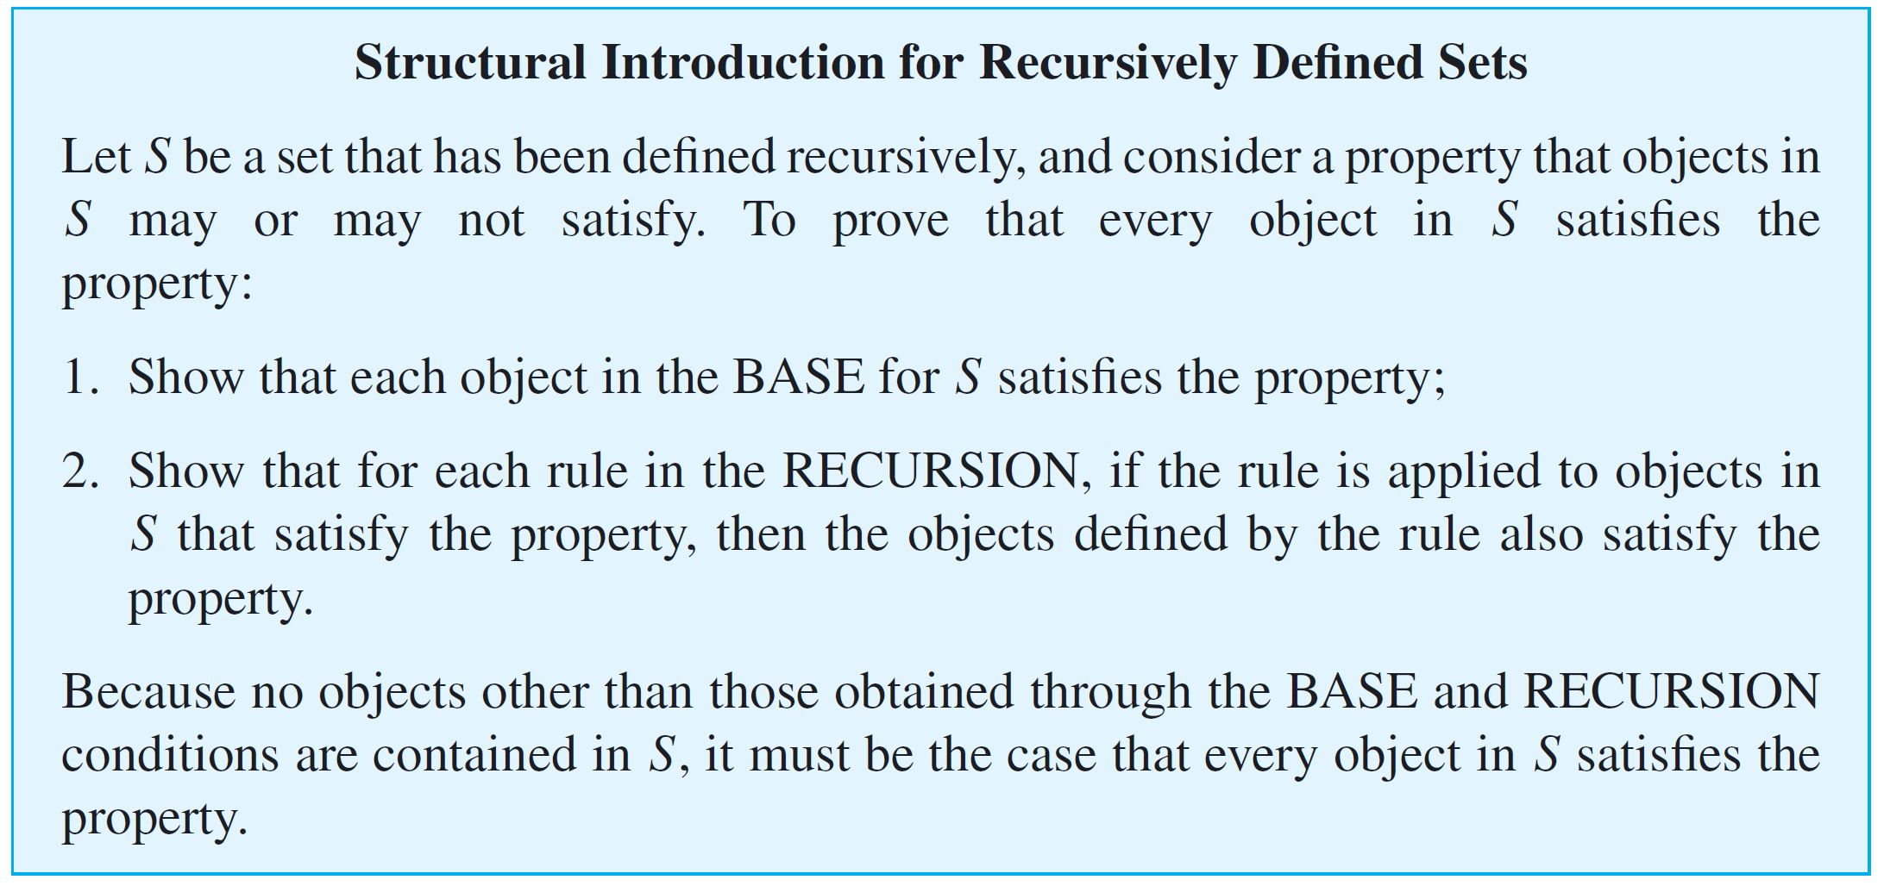
Proving Properties about Recursively Defined Sets

Slide 15
Example 5 – A Property of the Set of Parenthesis Structures
Consider the set P of all grammatical configurations of parentheses defined in Example 4. Prove that every configuration in P contains an equal number of left
and right parentheses.
Solution:
Proof (by structural induction):
Given any parenthesis configuration, let the property be the claim that it has an equal number of left and right parentheses.
Show that each object in the BASE for P satisfies the property: The only object in the base for P is (), which has one left parenthesis and one right parenthesis, so it has an equal number of left and right parentheses.

Slide 16
Example 5 – Solution
cont’d
Show that for each rule in the RECURSION for P, if the rule is applied to an object in P that satisfies the property, then the object defined by the rule also satisfies the property: The recursion for P consists of two rules denoted II(a) and II(b).
Suppose E is a parenthesis configuration that has an equal number of left and right parentheses.
When rule II(a) is applied to E, the result is (E), so both the number of left parentheses and the number of right parentheses are increased by one.
Since these numbers were equal to start with, they remain equal when each is increased by one.

Slide 17
Example 5 – Solution
cont’d
Suppose E and F are parenthesis configurations with equal numbers of left and right parentheses. Say E has m left and right parentheses, and F has n left and right parentheses.
When rule II(b) is applied, the result is EF, which has an equal number, namely m + n, of left and right parentheses.
Thus when each rule in the RECURSION is applied to a configuration of parentheses in P with an equal number of left and right parentheses, the result is a configuration with an equal number of left and right parentheses.
Therefore, every structure in P has an equal number of left and right parentheses.

Slide 18
Recursive Functions

Slide 19
Recursive Functions
A function is said to be defined recursively or to be a recursive function if its rule of definition refers to itself.
Because of this self-reference, it is sometimes difficult to tell whether a given recursive function is well defined.
Recursive functions are of great importance in the theory of computation in computer science.

Slide 20
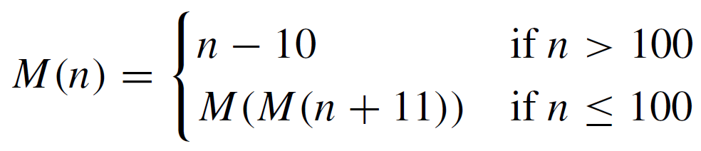
Example 6 – McCarthy’s 91 Function
The following function M : Z⁺ → Z was defined by John McCarthy, a pioneer in the theory of computation and in the study of artificial intelligence:
for all positive integers n. Find M(99).

Slide 21










Example 6 – Solution
By repeated use of the definition of M,

Slide 22
Example 6 – Solution
cont’d
The remarkable thing about this function is that it takes the value 91 for all positive integers less than or equal to 101.
Of course, for n > 101, M(n) is well defined because it equals n – 10.

Slide 23
Recursive Functions
The next example is a recursive “definition” that does not define a function.

Slide 24
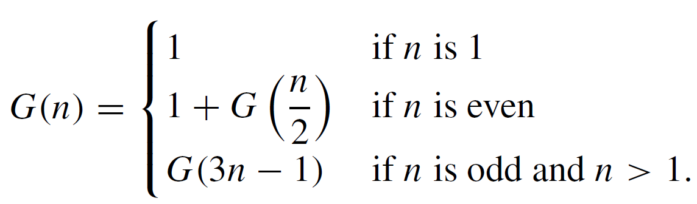
Example 8 – A Recursive “Function” That Is Not Well Defined
Consider the following attempt to define a recursive function G from Z⁺ to Z. For all integers n ≥ 1,
Is G well defined? Why?

Slide 25

Example 8 – Solution
Suppose G is a function. Then by definition of G,

Slide 26
Example 8 – Solution
cont’d
However,
Subtracting G(5) from both sides gives 0 = 3, which is false. Since the supposition that G is a function leads logically to a false statement, it follows that G is not a function.

Slide 27
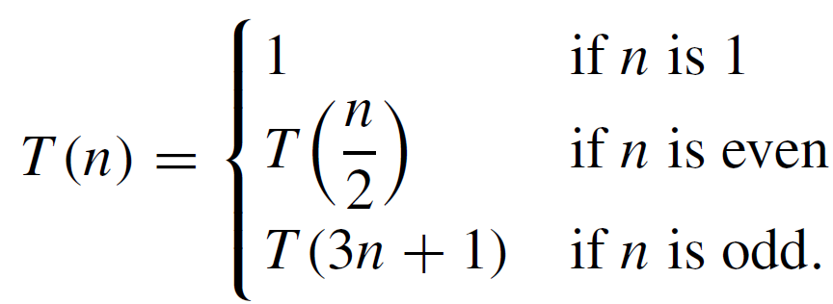
Recursive Functions
A slight modification of the formula of Example 8 produces a “function” whose status of definition is unknown. Consider the following formula: For all integers
n ≥ 1,
In the 1930s, a student, Luther Collatz, became interested in the behavior of a related function g, which is defined as follows: g(n) = n/2 if n is even, and g(n) = 3n + 1 if
n is odd.

Slide 28
Recursive Functions
Collatz conjectured that for any initial positive number n, computation of successive values of g(n), g²(n), g³(n), . . . would eventually produce the number 1.
Determining whether this conjecture is true or false is called the 3n + 1 problem (or the 3x + 1 problem).
If Collatz’s conjecture is true, the formula for T defines a function; if the conjecture is false, T is not well defined.

